Slide 1
KENYA
Forward Edge International

Slide 2
What is the “Forward Edge”….
When God directs people to put their faith into action and they respond with obedience-–even without knowing what lies ahead—they are stepping onto life's forward edge.
https://vimeo.com/67691033

Slide 3
Forward Edge focuses on: Reshaping the future of vulnerable children and restoring lives through disaster response
Forward edge seeks to provide holistic care meeting the physical, educational, and spiritual needs of children, their programs also work to empower their families and communities.
400 million children around the world today may not live to adulthood due to the effects if extreme poverty.
With your help Forward Edge programs in Haiti, Kenya, Nicaragua, and Mexico help more than 3,000 children flourish each year. Forward Edge provides food, safe water, education, and health care to support these children, their families, and their communities.

Slide 5
$38 a month!

Slide 6
What does sponsorship provide?
Nutritious meals
Health care
Safe drinking water
School tuition
Tutoring
An opportunity to hear the gospel
Bible training
Spiritual mentorship

Slide 7
If you cannot afford a $38/month sponsorship, you are welcome to give any amount to FEI’s Child in Need fund. Gifts to this fund help cover costs associated with children who are not fully sponsored, new children to the program, and unexpected additional needs of the children that may arise (and they often do!)

Slide 8
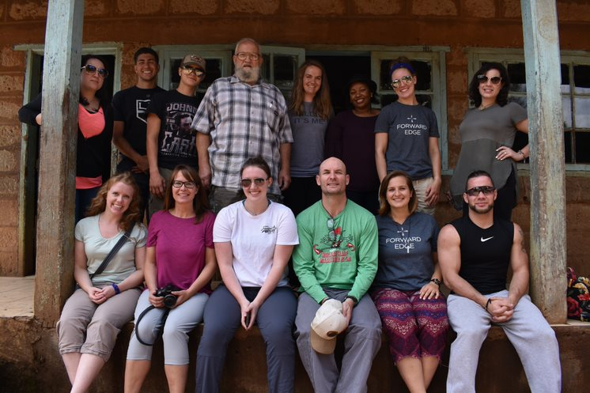
Team Photo

Slide 9
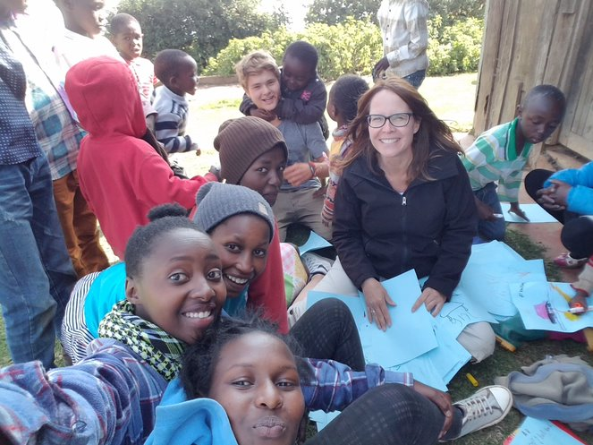

Slide 10
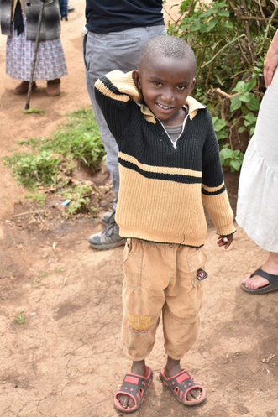
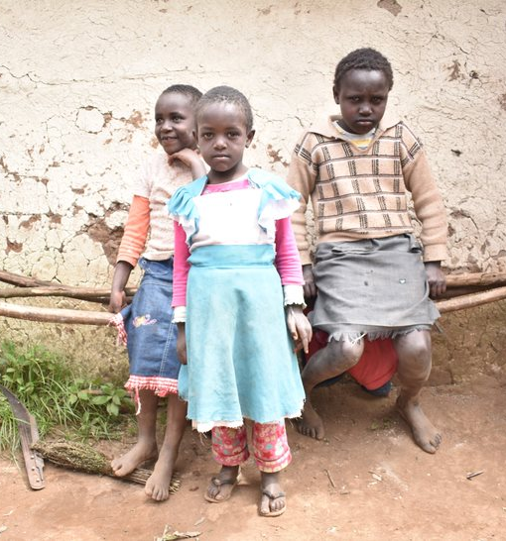
Kevin Gachau

Slide 11
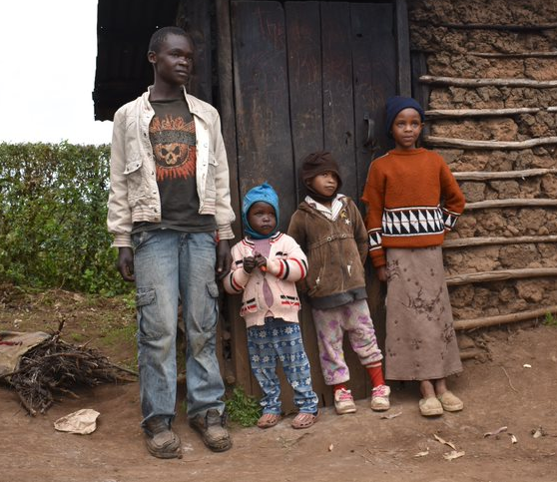
Joyce
Alex

Slide 12
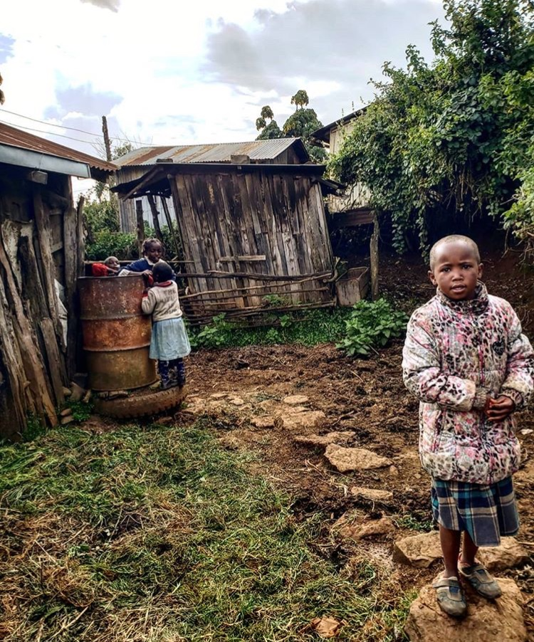

Slide 13
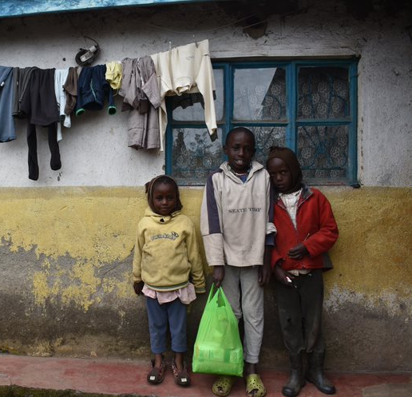

Slide 14
For more information and other ways you can serve with Forward Edge visit their website:
https://www.forwardedge.org

